Slide 1
FULLSTACK
Backend Programming

Slide 2
Map

Slide 3
Map
Map is one of associative data type in Golang
Each data has a key
Key must unique
The map data structure is used for: - fast lookups - retrieval - deletion of data based on keys
It is one of the most used data structures in computer science

Slide 4


Map - Declaration

Slide 5
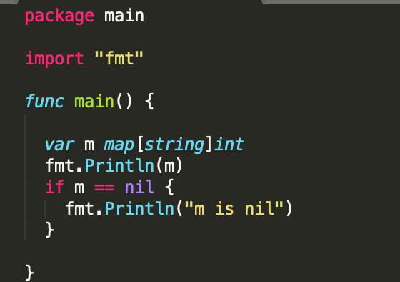
Map

Slide 6
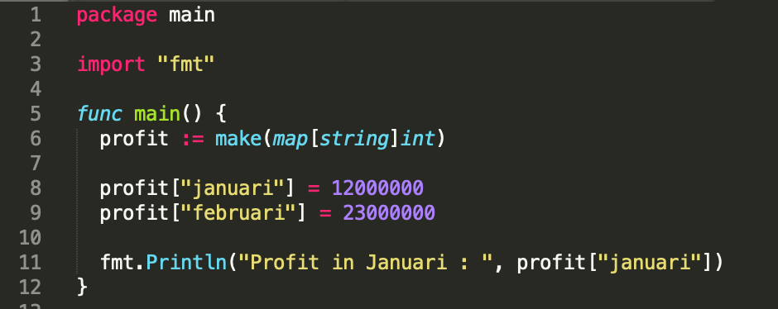
Map – Make() function

Slide 7
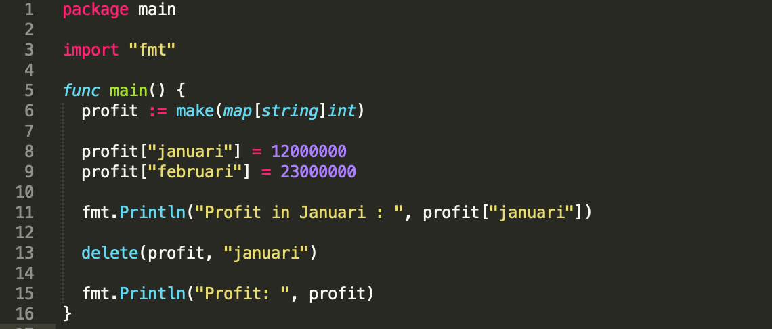
Map - Delete

Slide 8
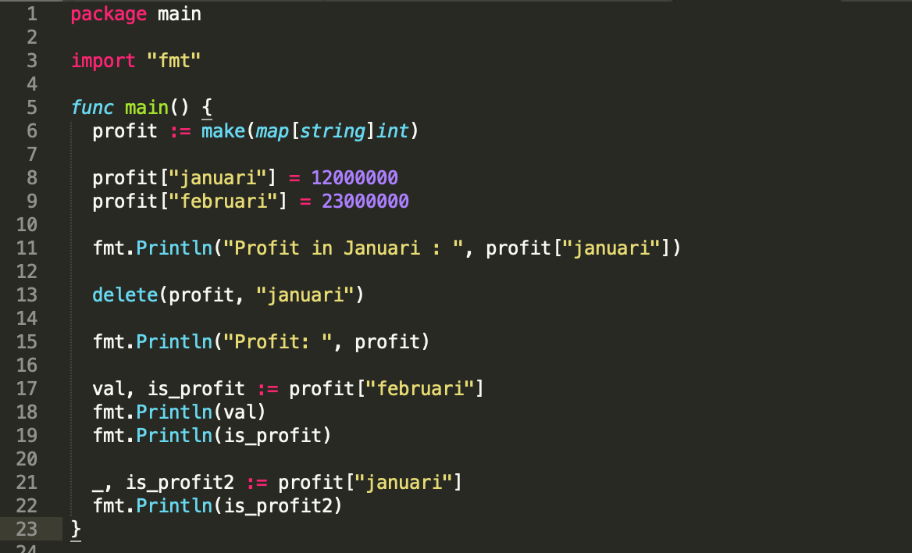
Map – check has a value

Slide 9

Let’s try !
According to the last code, Please add key value of januari = 11000000.

Slide 10
Range

Slide 11
Range
The range keyword is used in for loop to iterate over items of an array, slice, channel or map.

Slide 12
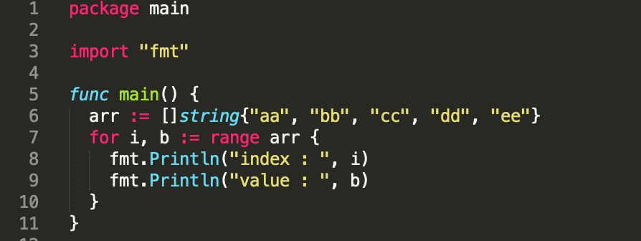
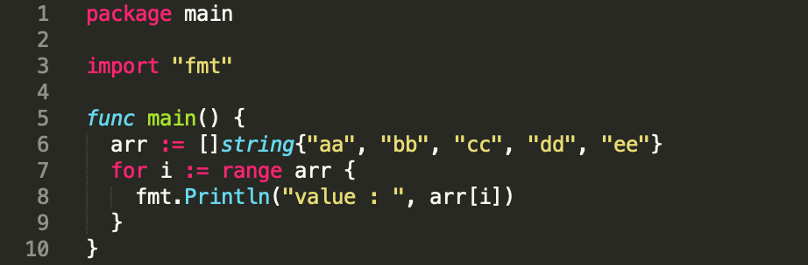
Range - Slice

Slide 13
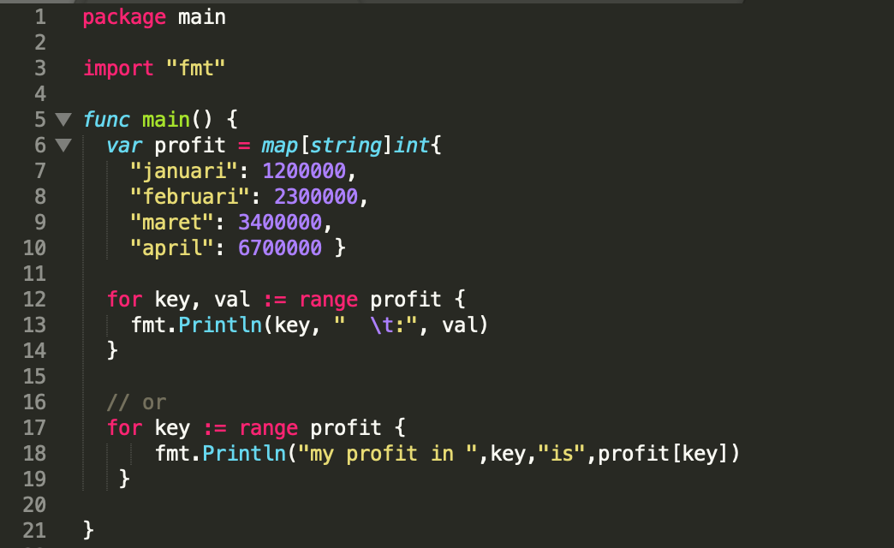
Range - Map

Slide 14
Let’s try !
Please use range slice and map for looping. a. Slice Arr = [22,33,44,55,66,77] b. Map Arr = [“aa”: 22, “bb”: 33, “cc”:44, “dd”:55, “ee”:66, “ff”:77]

Slide 15
Function

Slide 16
Function
A function is a group of statements that together perform a task.
Be able to get a return value or not

Slide 17
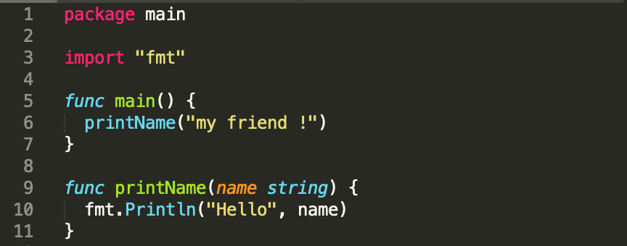
Function

Slide 18
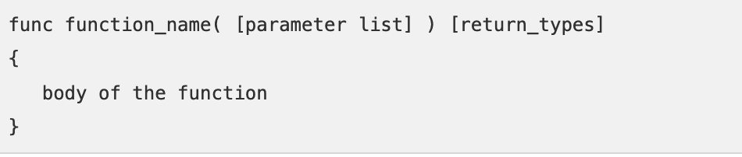
Function

Slide 19
Let’s try !
Make a calculator function. Add(), Multiply(). 2+4 2*4 Output : Add = 6 Multiply = 8

Slide 20
Summary
Map
Range
Function

Slide 21
